Slide 1

Simulating Heat Reversal with Quantum Computing
Saleh Naghdi
Supervised by Charles Hill and Thomas Quella
The University of Melbourne

Slide 2
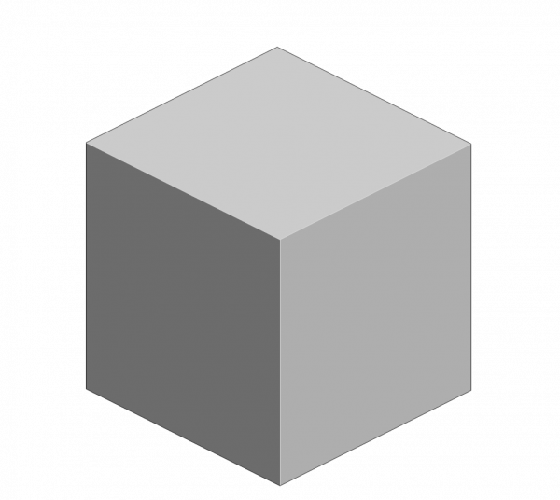




Consider two bodies
$$A$$
$$B$$
$$T_{A}>T_{B}$$

Slide 3


and Place them in thermal contact
$$B$$
$$A$$

Slide 4

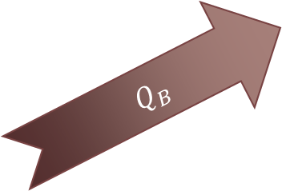
$$B$$
$Q_{B}$
$$A$$
$$Q_{B}\left(T_{A}−T_{B}\right)≥0$$

Slide 5

Quantum Picture?
$$B$$
$$A$$
$$Q_{B}\left(T_{A}−T_{B}\right)≥ΔI(A :B)$$

Slide 6


Quantum Picture?
$$B$$
$$A$$
$$Q_{B}$$
$$Q_{B}\left(T_{A}−T_{B}\right)≤0$$

Slide 7


Simulating on a quantum computer

Slide 8
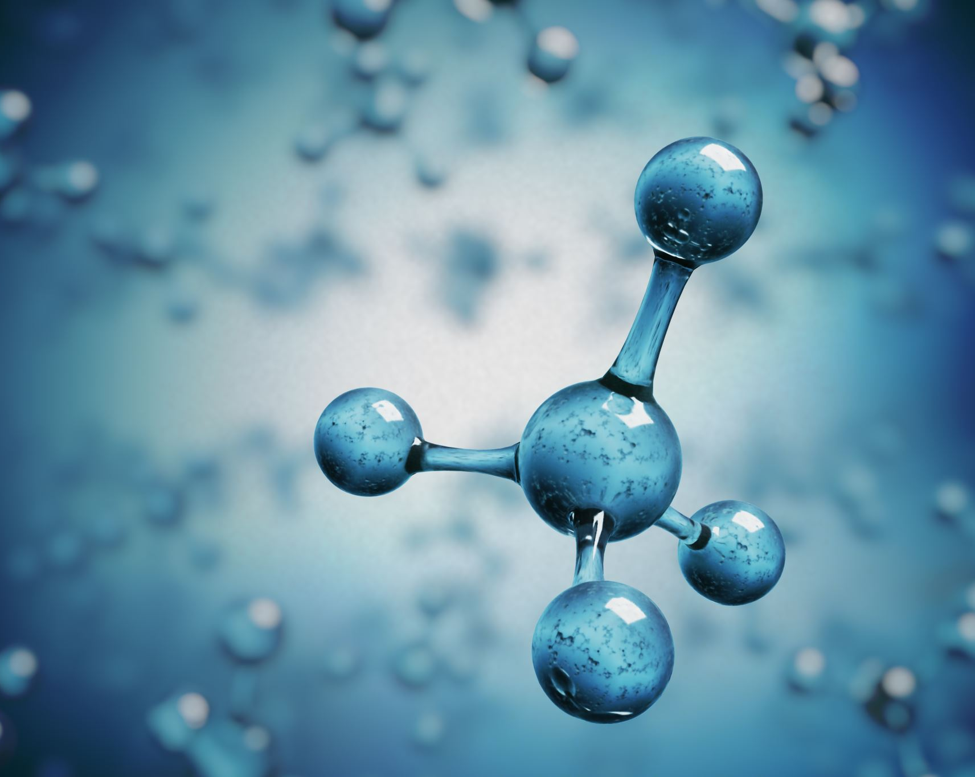
Step 1. Initial state preparation

Slide 9
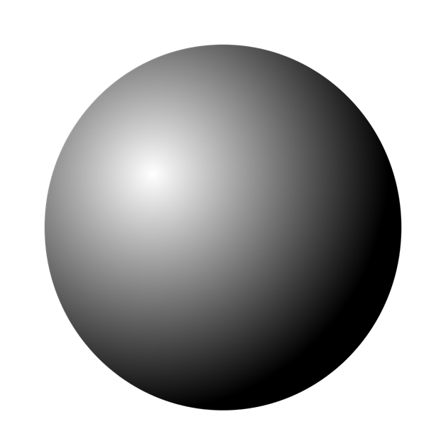
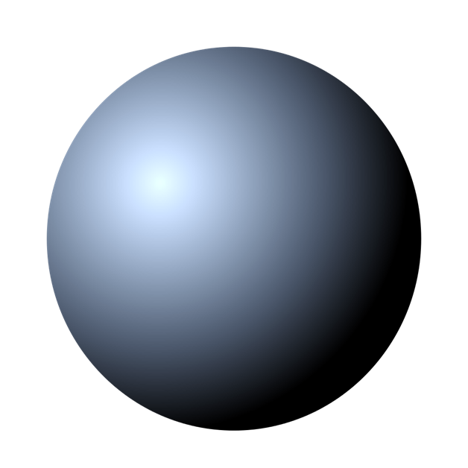
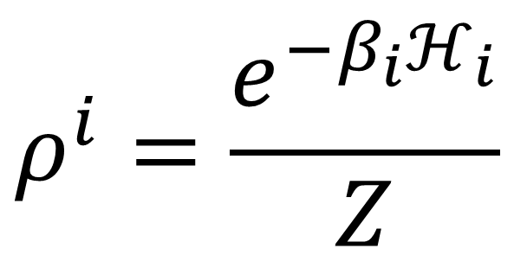
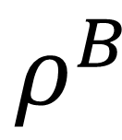
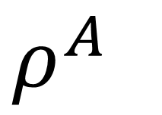
Consider two Quantum bodies in GIBBS STATES
$ρ^{A}$
$$ρ^{B}$$
$$ρ^{i}=\frac{e^{−β_{i}ℋ_{i}}}{Z}$$
Notes:
REDUCED DENSITY MATRIX
Define inverse temperature. TO BE ABLE TO TALK ABOUT CONCEPTS LIKE TEMPERATURE ON A QUANTUM SCALE, INTRODUCE GIBBS STATE
Say definitions out loud. Read through equation and explain each term individually “reduced density matrix of system i”
Spin-1/2 particle in field Hamiltonian

Slide 10
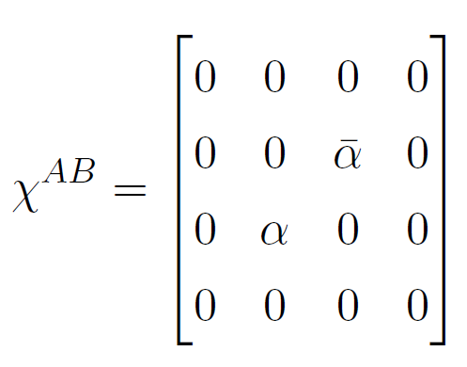
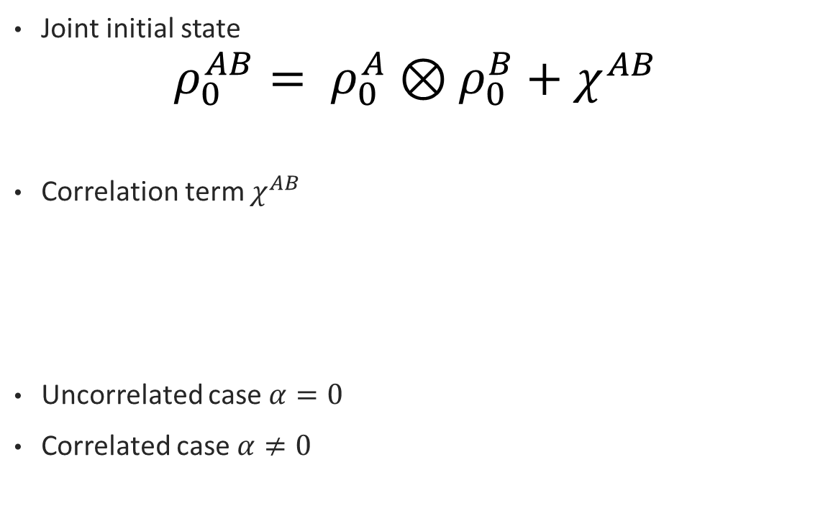
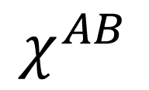
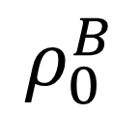

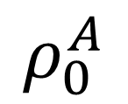
JOINT INITIAL STATE
$$χ^{AB}$$
Joint initial state
$${ρ_{0}^{AB}= ρ}_{0}^{A}⊗ρ_{0}^{B}+χ^{AB}$$
Correlation term $χ^{AB}$
Uncorrelated case $α=0$
Correlated case $α≠0$
$$ρ_{0}^{A}$$
$$ρ_{0}^{B}$$
$$ρ^{i}=\frac{e^{−β_{i}ℋ_{i}}}{Z}$$
(Micadei, K., Peterson, J.P.S., Souza, A.M. et al., Physical review. E, 2008)
Notes:
Don’t beat around the bush with the importance

Slide 11
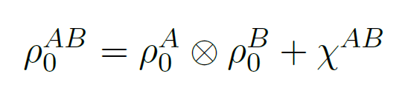
JOINT INITIAL STATE (CONTINUED)
Want to reliably prepare
Two steps:
Prepare a diagonal state (uncorrelated)
Generate the off-diagonal correlation terms
Generally non-diagonal (correlated) state
Diagonal state (uncorrelated)
Notes:
Define diagonal

Slide 12
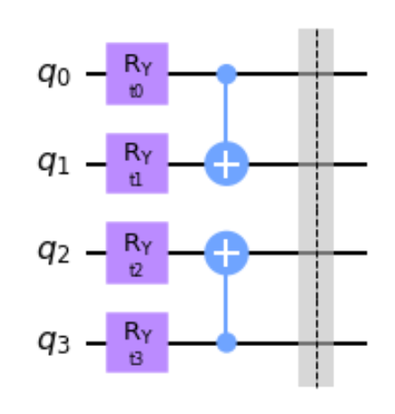
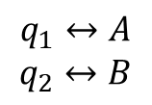
CIRCUIT FOR DIAGONAL STATE
Easy to produce using variational quantum computing
Use following parametrized
Arrive at a solution for parameters via some optimisation scheme
$$q_{1}↔A$$
$$q_{2}↔B$$

Slide 13
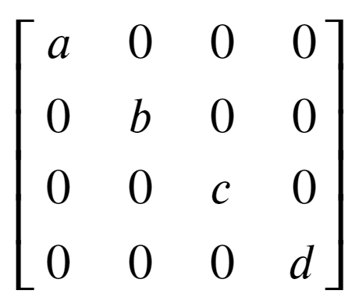
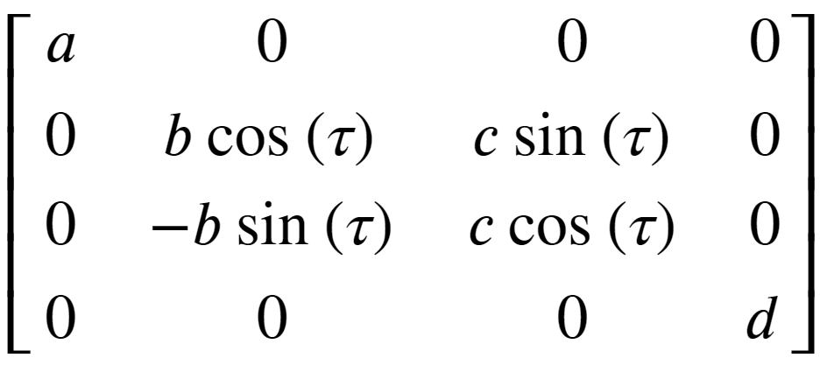
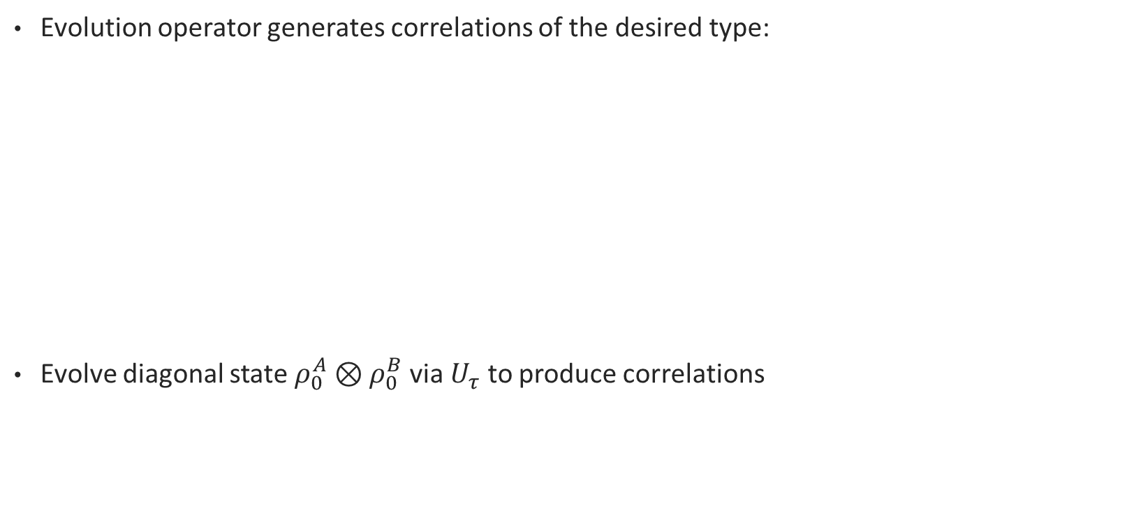
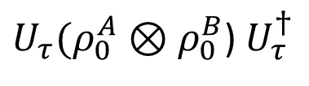
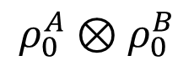
GENERATING off-diagonal terms
Evolution operator generates correlations of the desired type:
Evolve diagonal state $ρ_{0}^{A}⊗ρ_{0}^{B}$ via $U_{τ}$ to produce correlations
$$ρ_{0}^{A}⊗ρ_{0}^{B}$$
${U_{τ}(ρ}_{0}^{A}⊗ρ_{0}^{B}$) $U_{τ}^{†}$

Slide 14
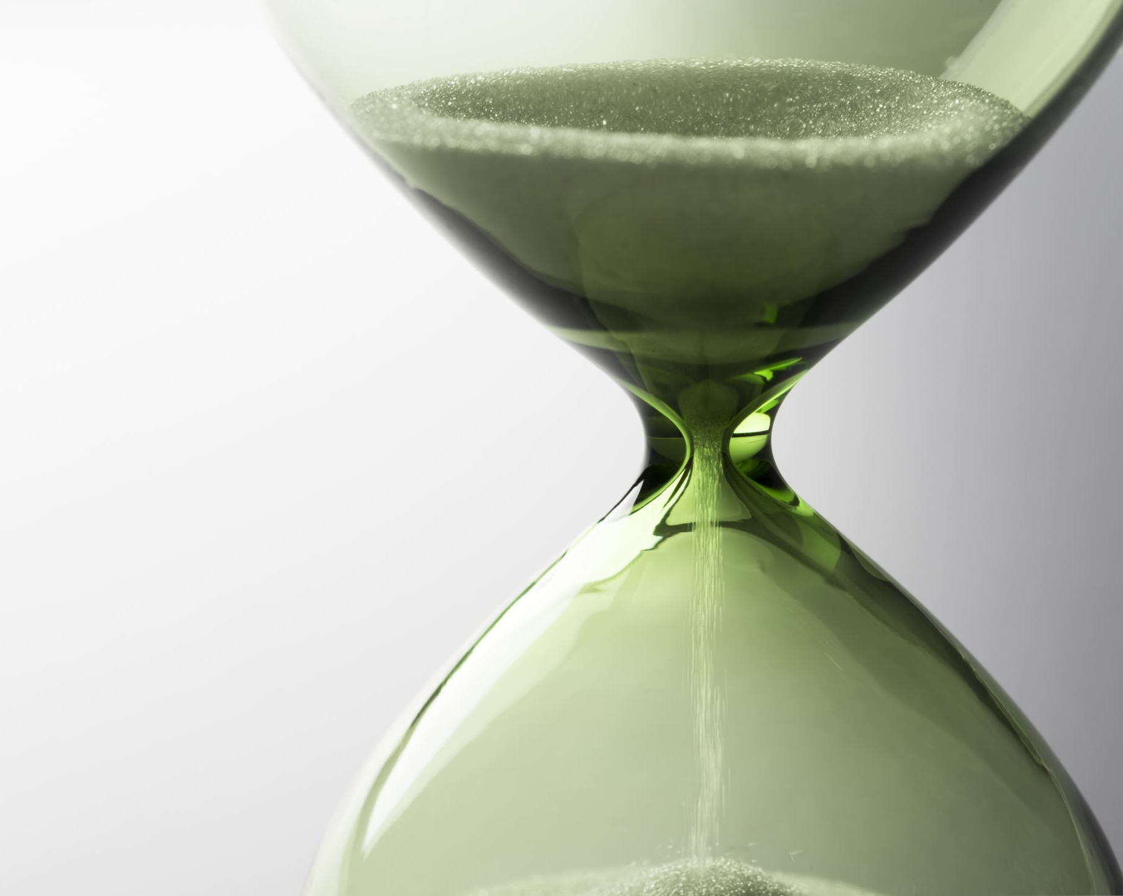
Thermalisation evolution

Slide 15
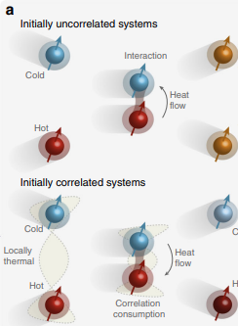
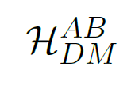
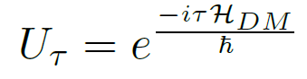
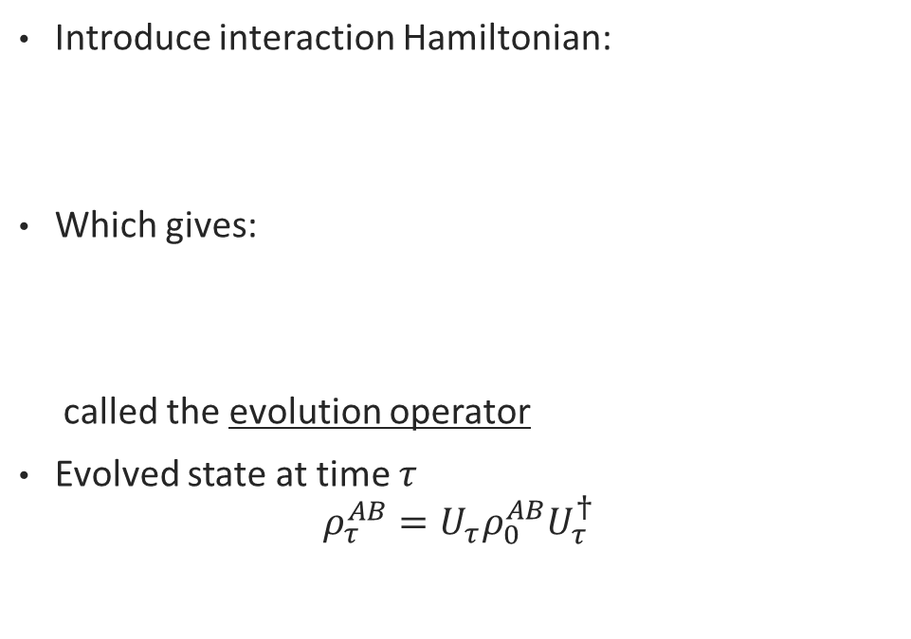
How to bring two qubits into ‘thermal contact’?
Introduce interaction Hamiltonian:
Which gives:
called the evolution operator
Evolved state at time $τ$
$$ρ_{τ}^{AB}=U_{τ}ρ_{0}^{AB}U_{τ}^{†}$$
(Micadei, K., Peterson, J.P.S., Souza, A.M. et al., Physical review. E, 2008)
Notes:
Dagger symbol

Slide 16
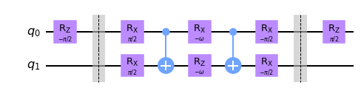
Evolution operator
The DM evolution
Can be carried out using the following circuit
(optimised from 4 to 2 CNOTs)

Slide 17
Results

Slide 18
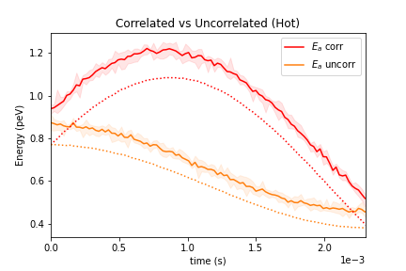
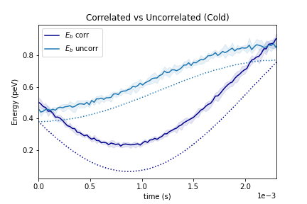
¹Results generated on the ibmq_bogota quantum backend
Notes:
WHY ARE QUBITS HOTTER?
**Errors tend to gravitate state towards equal mixture from the true mixture (
Noise in: gate and readout (decoherence) (imprecision in measuring devices)
Label each

Slide 19
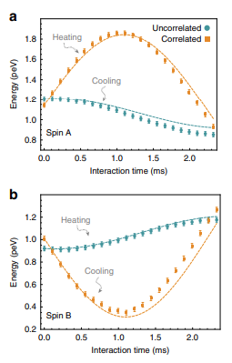

Slide 20

Generalisation to larger Systems

Slide 21
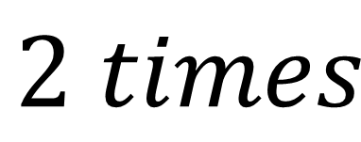
Take the original 2-qubit pair
$$2 times$$

Slide 22
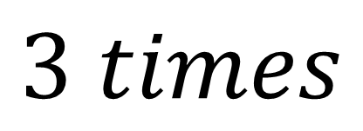
And Extend
$$3 times$$

Slide 23
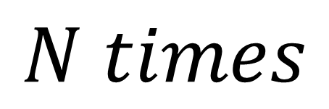
To an n-qubit chain
….
$$N times$$

Slide 24
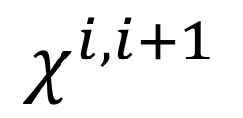

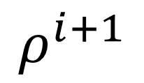
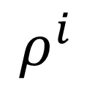
Generalising the INITIAL STATE
$$χ^{i,i+1}$$
….
….
$$ρ^{i}$$
$$ρ^{i+1}$$
$$ρ_{0}^{i}⊗ρ_{0}^{i+1}+χ^{i,i+1}$$

Slide 25
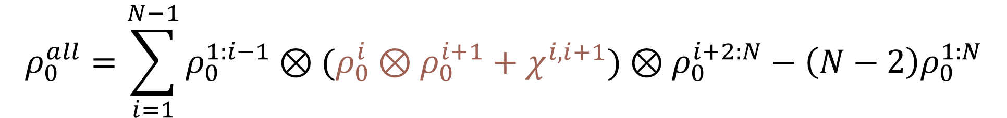
Generalising the initial state
$$χ^{i,i+1}$$
….
$$ρ^{i}$$
$$ρ^{i+1}$$
$$ρ_{0}^{all}=\sum_{i=1}^{N−1}{{ρ_{0}^{1:i−1}⊗(ρ}_{0}^{i}⊗ρ_{0}^{i+1}+χ^{i,i+1})⊗ρ_{0}^{i+2:N}−\left(N−2\right)ρ_{0}^{1:N}}$$

Slide 26

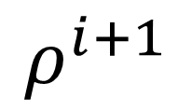
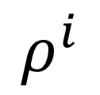
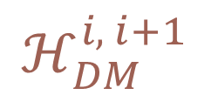
Generalising the thermalisation interaction
….
….
$$ρ^{i}$$
$$ρ^{i+1}$$
$$ℋ_{DM}^{i, i+1 }$$

Slide 27
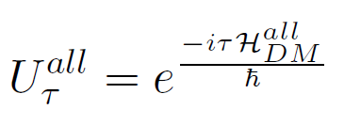
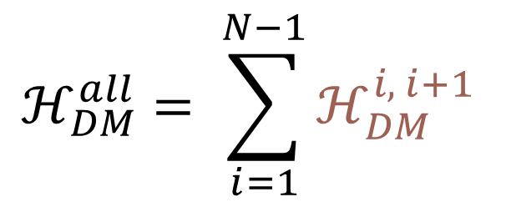

Generealising the thermalisation interaction
….
$$ℋ_{DM}^{all}= \sum_{i=1}^{N−1}{ℋ_{DM}^{i, i+1 }}$$
$$⇒$$

Slide 28
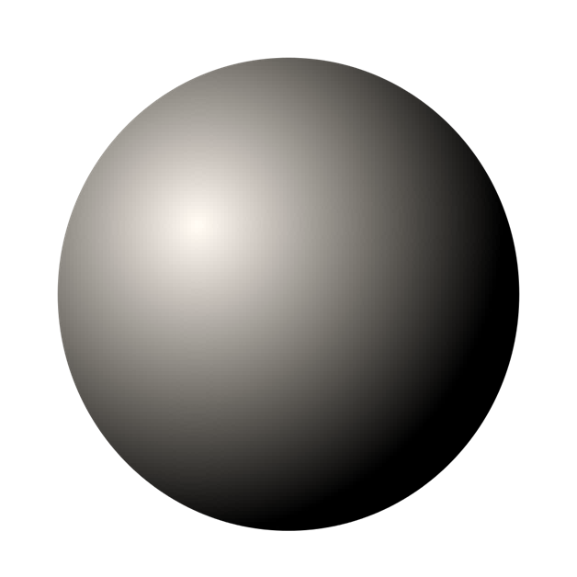
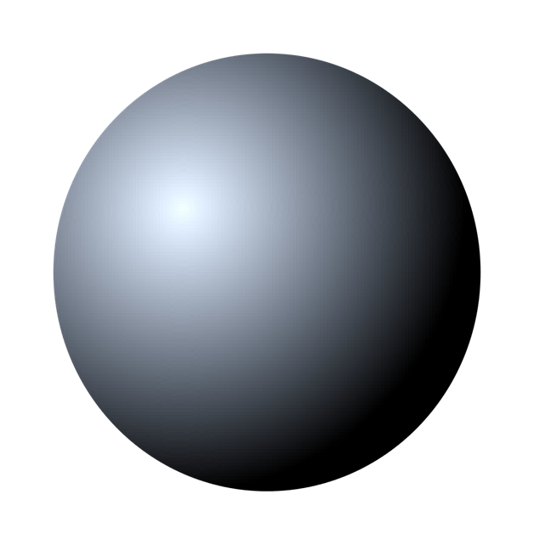
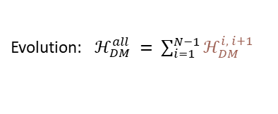
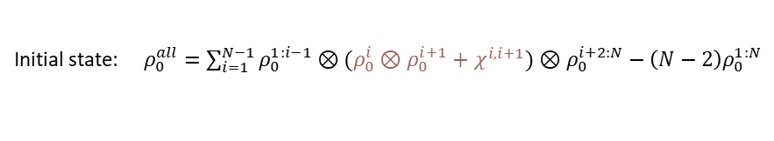
NOW ADD TEMPERATURE GRADIENT
….
Evolution: ${ ℋ}_{DM}^{all} = \sum_{i=1}^{N−1}{ℋ_{DM}^{i, i+1 }}$
Initial state: ${ ρ}_{0}^{all} =\sum_{i=1}^{N−1}{{ρ_{0}^{1:i−1}⊗(ρ}_{0}^{i}⊗ρ_{0}^{i+1}+χ^{i,i+1})⊗ρ_{0}^{i+2:N}−\left(N−2\right)ρ_{0}^{1:N}}$

Slide 29
NOW ADD TEMPERATURE GRADIENT
….
Evolution: ${ ℋ}_{DM}^{all} = \sum_{i=1}^{N−1}{ℋ_{DM}^{i, i+1 }}$
Initial state: ${ ρ}_{0}^{all} =\sum_{i=1}^{N−1}{{ρ_{0}^{1:i−1}⊗(ρ}_{0}^{i}⊗ρ_{0}^{i+1}+χ^{i,i+1})⊗ρ_{0}^{i+2:N}−\left(N−2\right)ρ_{0}^{1:N}}$

Slide 30
As well as correlations
….
Evolution: ${ ℋ}_{DM}^{all} = \sum_{i=1}^{N−1}{ℋ_{DM}^{i, i+1 }}$
Initial state: ${ ρ}_{0}^{all} =\sum_{i=1}^{N−1}{{ρ_{0}^{1:i−1}⊗(ρ}_{0}^{i}⊗ρ_{0}^{i+1}+χ^{i,i+1})⊗ρ_{0}^{i+2:N}−\left(N−2\right)ρ_{0}^{1:N}}$

Slide 31
Method?

Slide 32
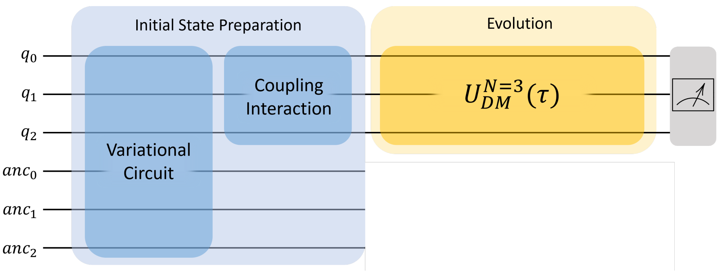
SCHEMATIC

Slide 33
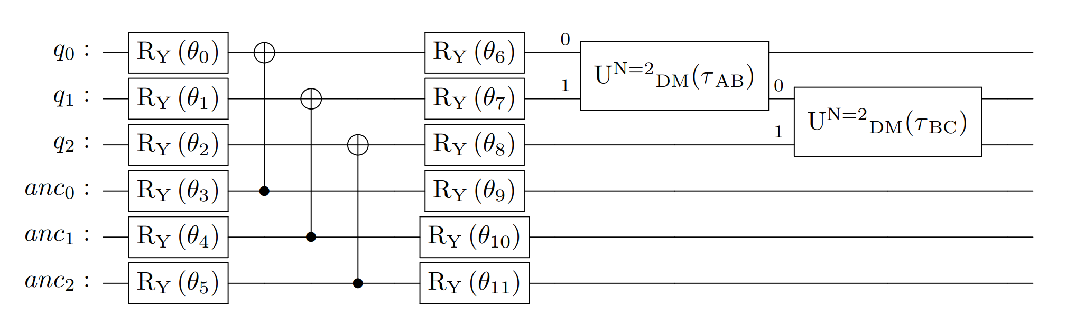
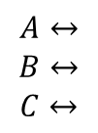
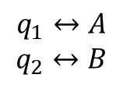
ISP: preparing diagonal state
2 QUBITS
3 QUBITS
$$A↔$$
$$B↔$$
$$C↔$$
$$q_{1}↔A$$
$$q_{2}↔B$$

Slide 34

ISP: GENERATING CORRELATION TERMS diagonal state
$$A↔$$
$$B↔$$
$$C↔$$

Slide 35
ISP: GENERATING CORRELATION TERMS diagonal state
$$A↔$$
$$B↔$$
$$C↔$$

Slide 36


Evolution operator
2 QUBITS
Minimise
$$↑$$
3 QUBITS

Slide 37
RESULTS for the 3-qubit case

Slide 38




Notes:
Labeell states (ithout/with corrltios

Slide 39




Notes:
Green dot on C

Slide 40

working towards minimising noise

Slide 41


Slide 42


Slide 43


Slide 44


Slide 45


Slide 46


Slide 47


Slide 48


Slide 49




















$$Classical$$
$$Preferential$$
$$A$$
$$B$$
$$C$$
$$A$$
$$B$$
$$C$$
$$Reversal$$
$$A$$
$$B$$
$$C$$
$$Local Effects$$
$$A$$
$$B$$
$$C$$
$$A$$
$$B$$

Slide 50

CONCLUSION
Reproduced heat reversal on the QC for the 2-and 3- qubit case
Formulated a possible N-qubit chain generalization
Moving forward:
To obtain results for more exotic qubit arrangements on a real quantum backend.
Quantifying effect of noise
Notes:
In summary…

Slide 51
Thank you

Slide 52
References
Partovi, M. Hossein. (2008). Entanglement versus Stosszahlansatz: Disappearance of the thermodynamic arrow in a high-correlation environment. Physical review. E, Statistical, nonlinear, and soft matter physics. 77. 021110. 10.1103/PhysRevE.77.021110.
Micadei, K., Peterson, J.P.S., Souza, A.M. et al. (2019). Reversing the direction of heat flow using quantum correlations. Nat Commun 10, 2456 https://doi.org/10.1038/s41467-019-10333-7
Efekan Kökcü and Thomas Steckmann and J. K. Freericks and Eugene F. Dumitrescu and Alexander F. Kemper. (2021) Fixed Depth Hamiltonian Simulation via Cartan Decomposition. arXiv 2104.00728
Notes:
correlation terms do not necessarily imply entanglement, but instead coherence. entangled states cannot be written separably.

Slide 53
Experimental confirmation WITH NMR
Hotter body
Colder body
(Micadei, K., Peterson, J.P.S., Souza, A.M. et al., Nat Commun 10, 2019)
Notes:
Reference: journal and year
Label a and b: hotter and colder
Don’t say “kind of”
Definition of mutual information
Technological applications <

